Slide 1
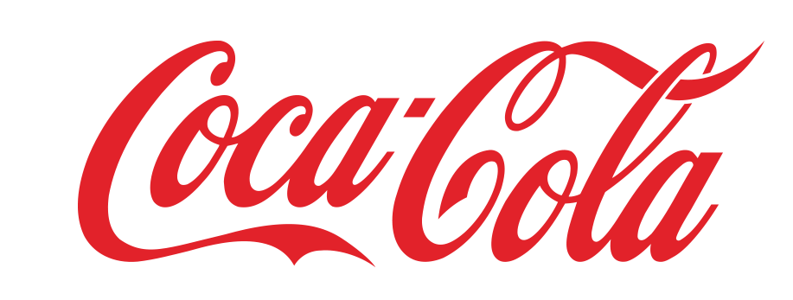


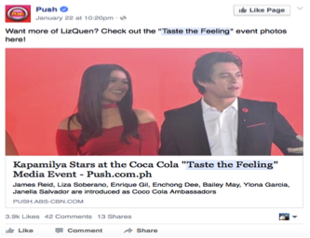
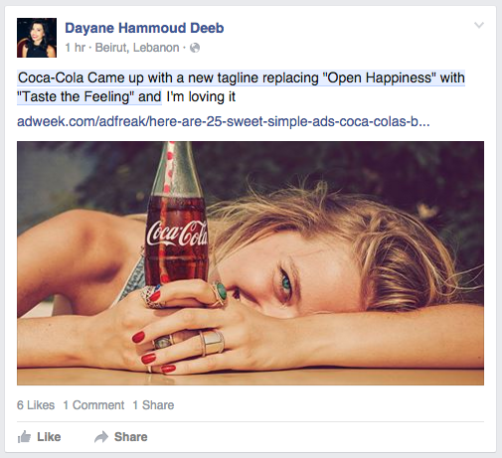
Insights Summary – Flash Insights
PURPOSE: Insightpool aggregated every Facebook interaction relative to “Taste the Feeling” over a two week window beginning on January 21st. The purpose of this flash analysis was to determine initial receptivity and conversation around the announcement of the campaign by Coca-Cola Leadership which was kicked off by an article in Advertising Age on January 19th. The analysis utilizes Facebook Topic Data which is the real-time aggregated stream of data captured from 100% of the conversations and interactions taking place on Facebook globally to leverage the following findings.
Level of Conversation & Conversation Cycle: Level of conversation - peaked at announcement and came down from there (typical).
Conversation cycle followed 4 stages: Media; Advocates; Shared Content (Emotional Resonance); 3rd Party Uptake
(2) Emotional resonance: Very positive response/feelings
Global Response: Conversation was global and those global conversations centered on specific activation in market timed to the announcement
3rd Party Conversations: Conversations drove to intended campaign content, BUT Competitive fire and use of trademark issue were a bit
watch out item.
Media
Advocates
Shared Content
3rd Party
160,000
###
###
###
Interactions
(w/ Taste the Feeling)
Regions
25-34
Marketers
International
Philippines, Columbia
Celebrities
Regions
Demographic
Celebrities
USA
Health/Bully
Brands/Media
USA
Poland
3%
Germany
4%
Romania
Philippines
12%
4%
36%
5%
5%
Columbia
Italy
9%
India
Ecuador
3%
Chile
8%
Media - Sample Post
Advocates - Sample Post
Shared Content - Sample Post

Slide 2
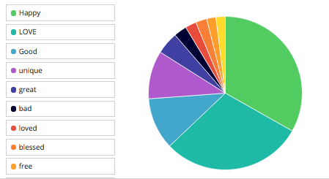
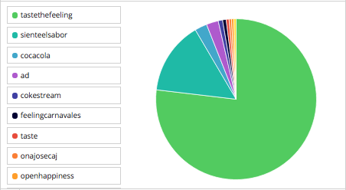
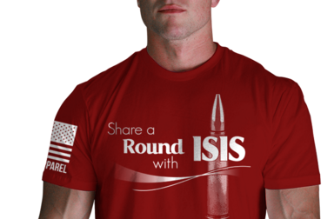
Emotional Resonance
Hashtags
More than 95% of feelings associated with the campaign were positive. “Bad” was the first negative feeling with 2%
The hashtags were positive and relatively predictable. Fortunately, the opposition to the campaign was not clever enough to link their efforts to a hashtag
Links
The most surprising link was one associated with “Share a Coke” that used Coke’s likeness in association with the terrorist group, ISIS.
Share Happiness Link
http://nine.li/1OxbCBc
Media Link
http://adage.com/article/cmo-strategy/coke-debuts-taste-feeling-campaign-strategic-shift/302184/
Advocate Link
http://push.abs-cbn.com/albums/3528/kapamilya-stars-at-the-coca-cola-taste-the-feeling-media-event/
GIF creator Domain
spr.ly

